Slide 1
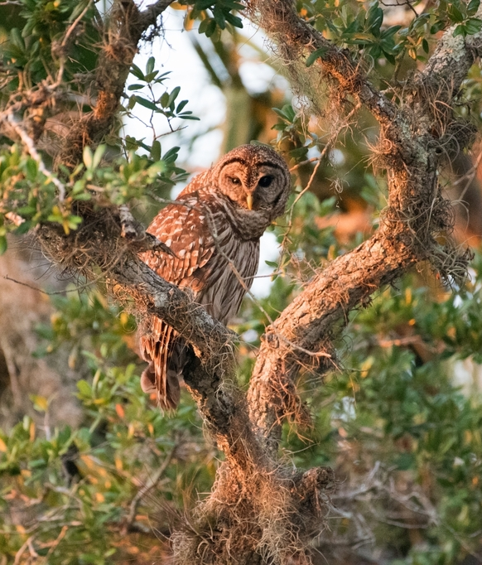


A comprehensive literature review on the use of iNaturalist data in scientific research
Brittany M. Mason and Corey T. Callaghan

Slide 2
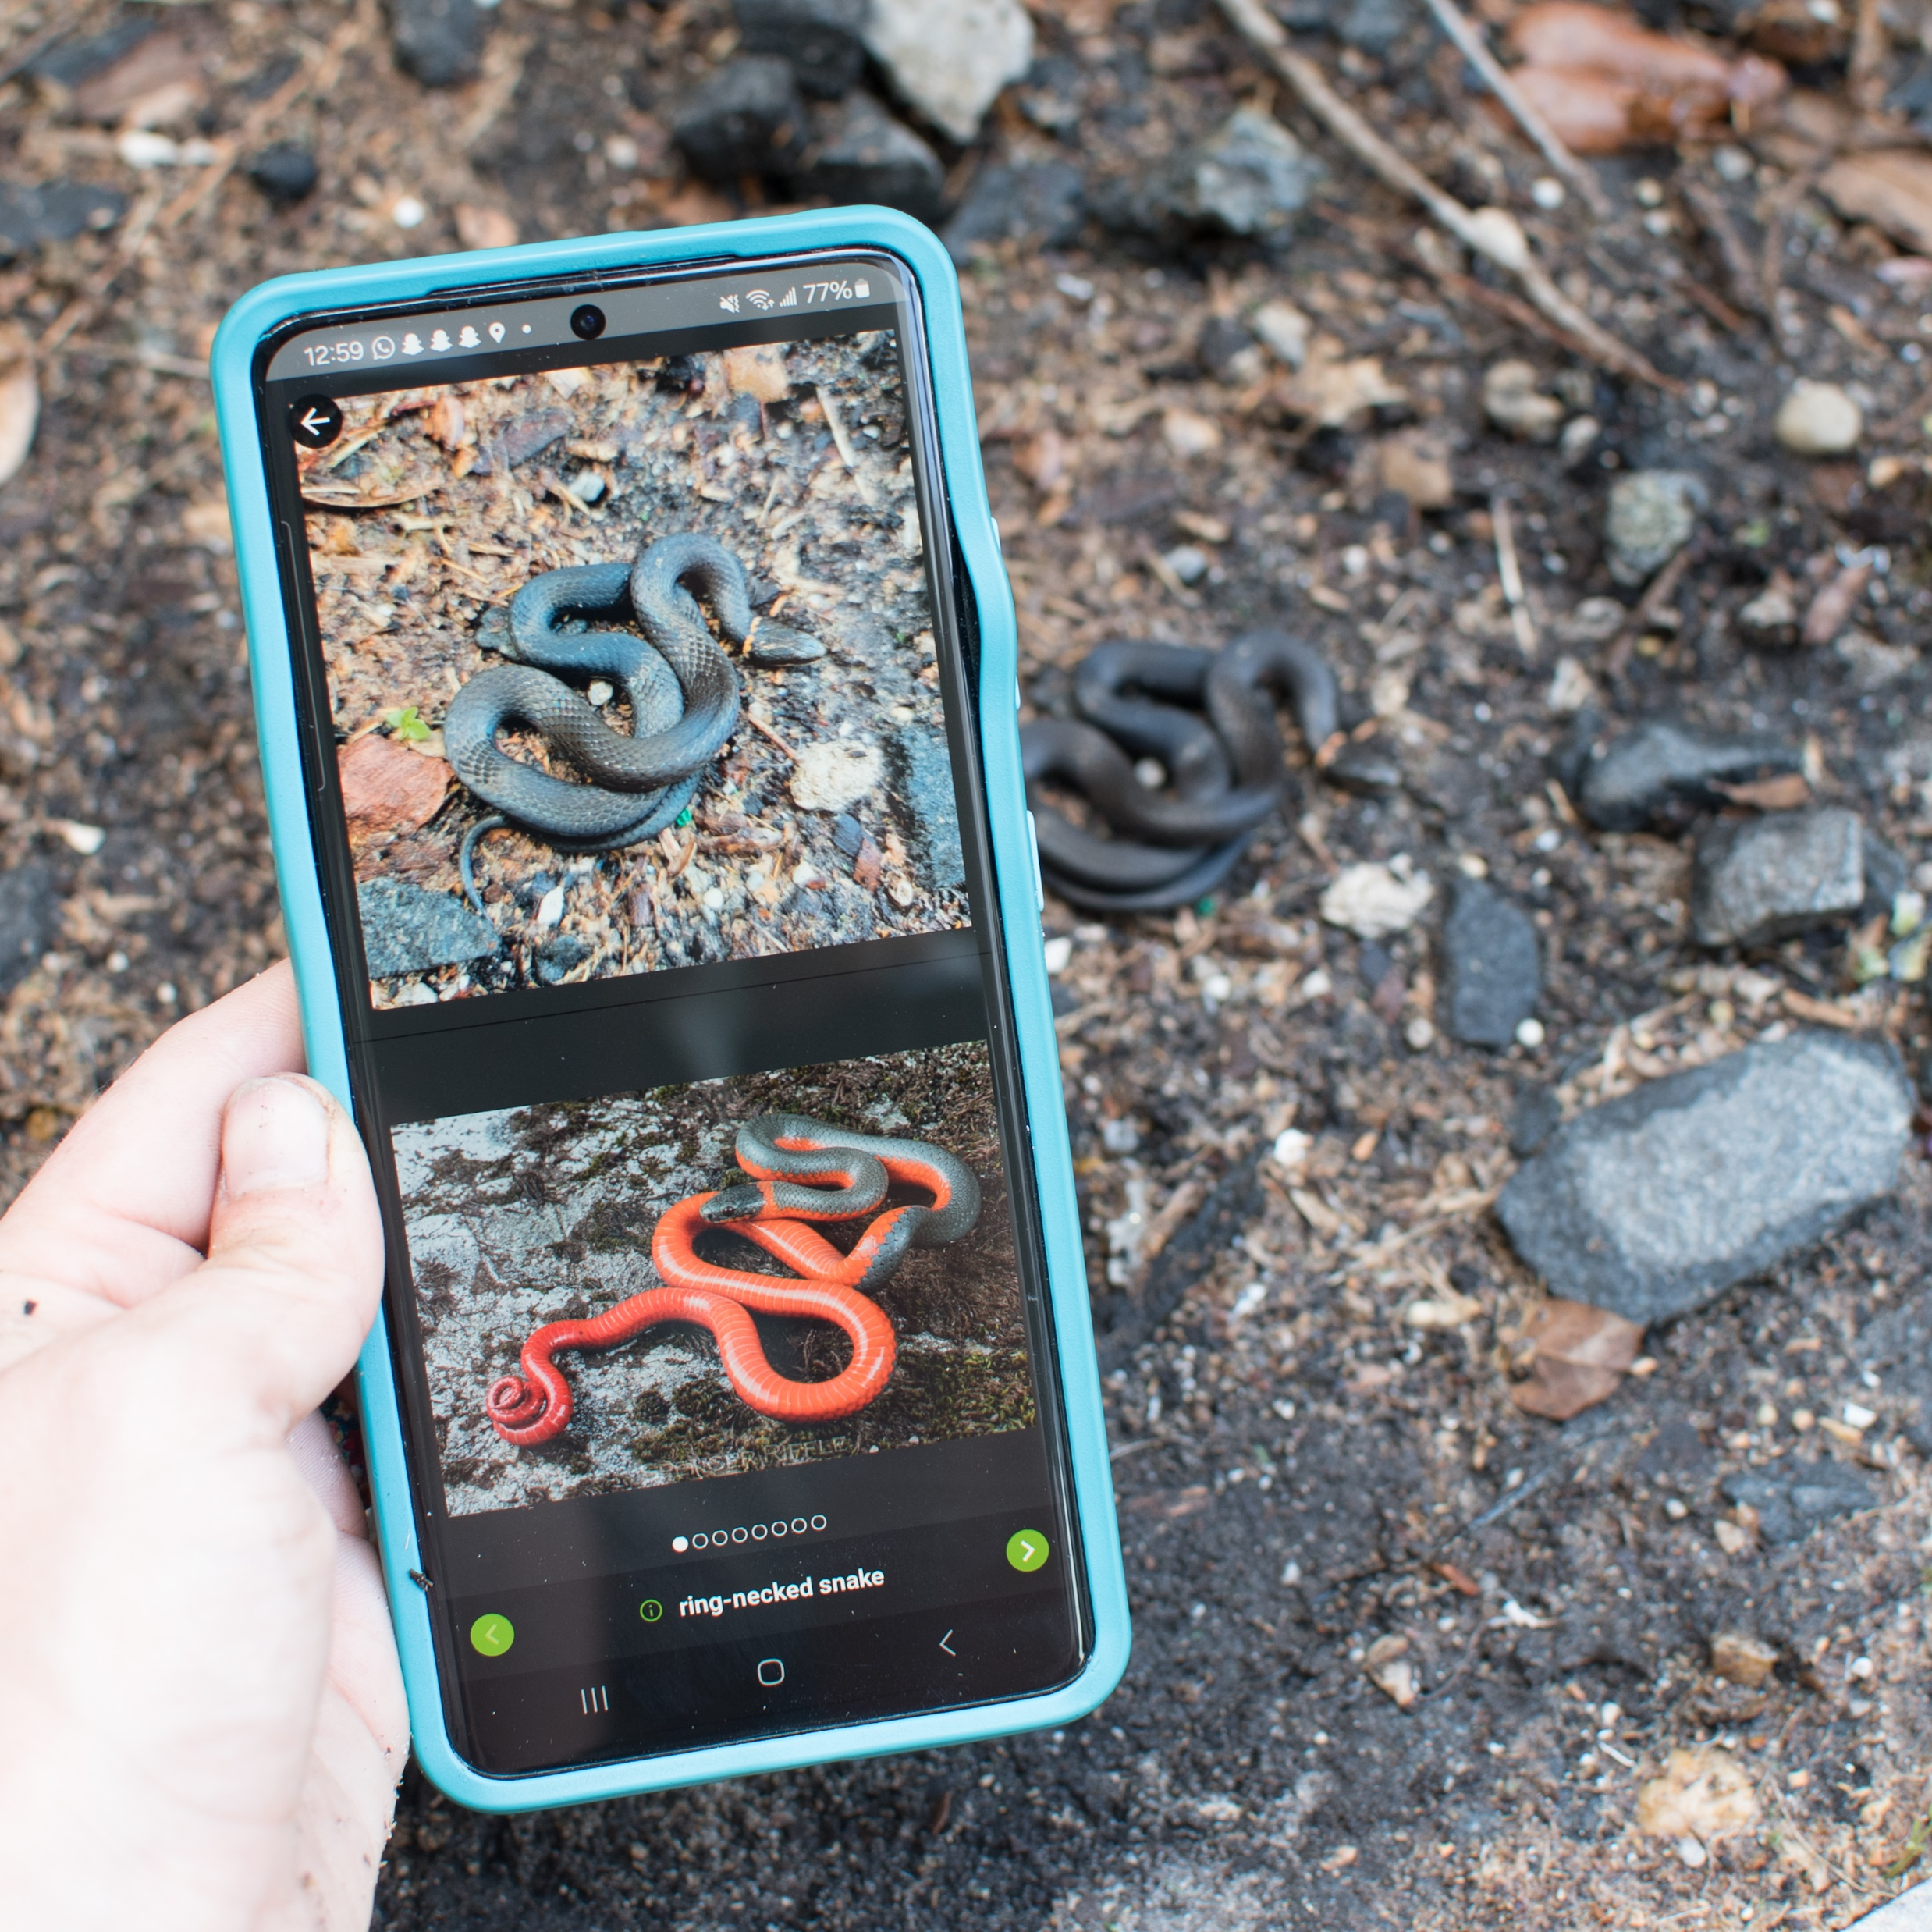

What is iNaturalist?
A global platform where users submit observations of any living thing using either the application or website
A community of naturalists then provide identification suggestions, and when the observation reaches over 2/3rds agreement the data becomes “Research Grade”
iNaturalist mission: “Connect people to nature and advance biodiversity science and conservation”

Slide 3
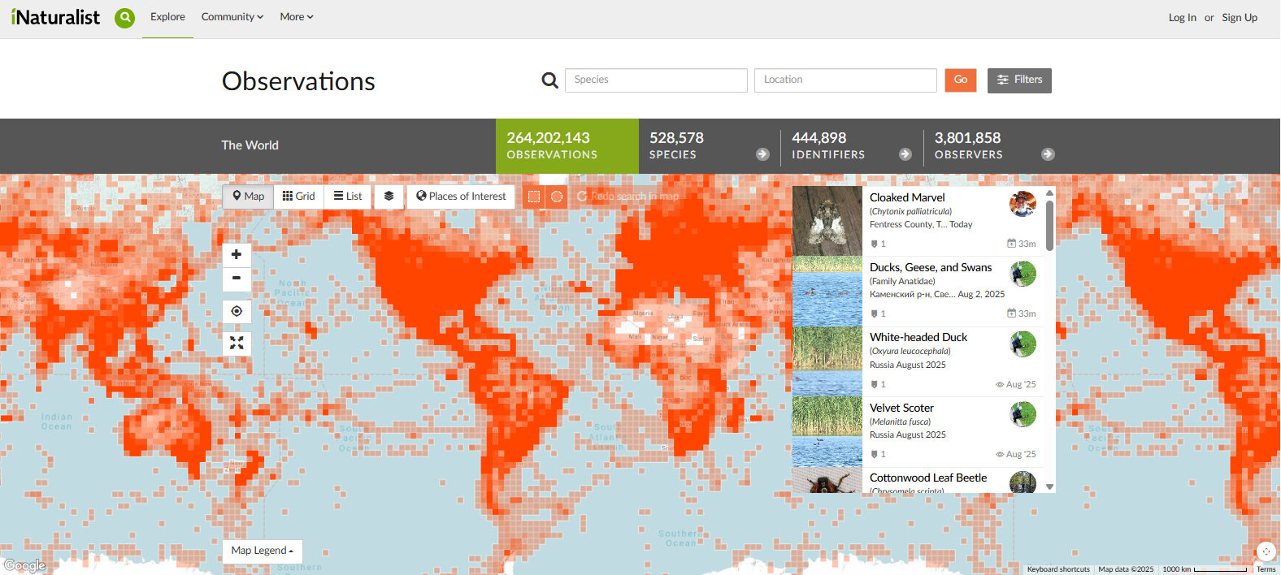
Notes:
This platform is very popular, with 3.8 million users and over 250 million observations!

Slide 4
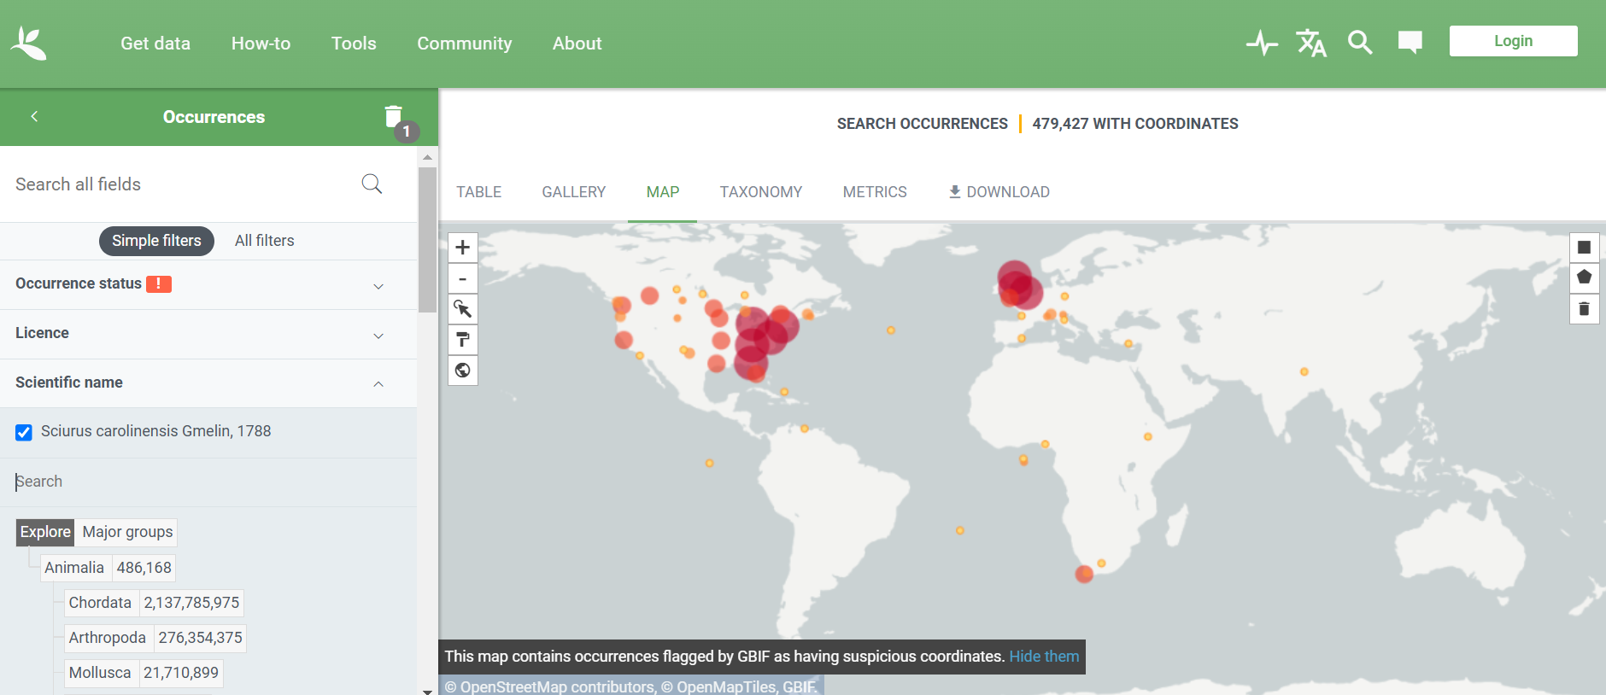
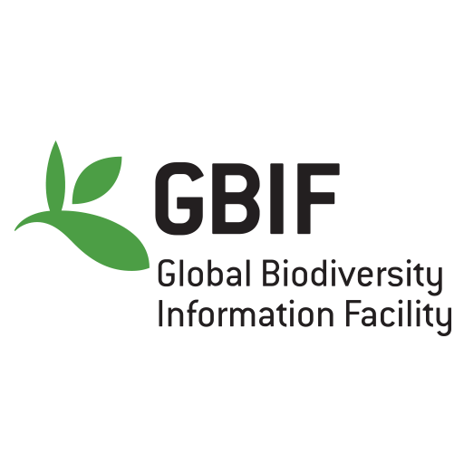
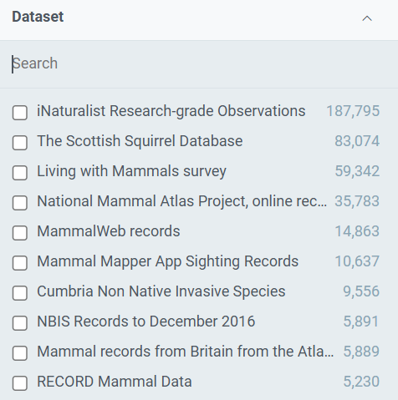
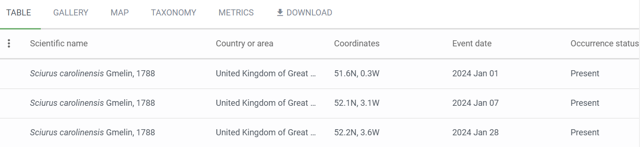
Notes:
Once the iNaturalist data becomes “Research Grade”, following appropriate licensing and data quality conditions, it is shared with the Global Biodiversity Information Facility. Researchers can use this to website to download the iNaturalist data and are provided a DOI to cite the dataset.

Slide 5
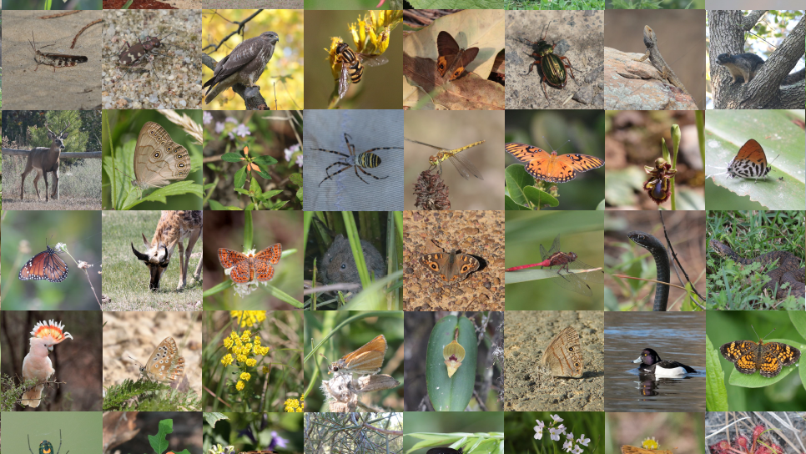
How are researchers using this data?

Slide 6
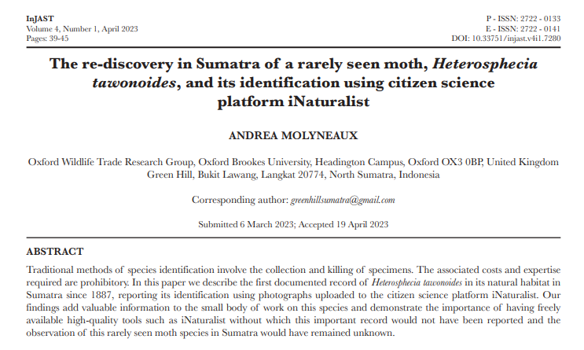
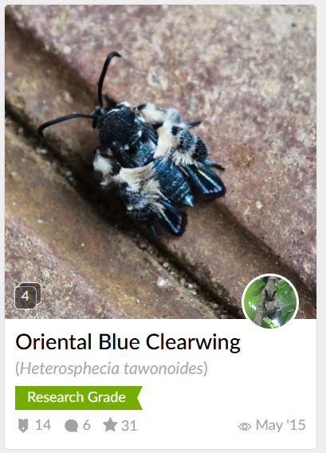
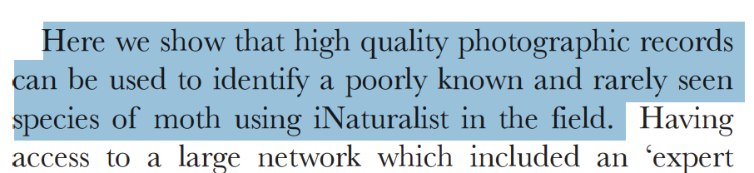
Molyneaux, A. (2023). The re-discovery in Sumatra of a rarely seen moth, Heterosphecia tawonoides, and its identification using citizen science platform iNaturalist. Indonesian Journal of Applied Environmental Studies, 4(1), 39-45.

Slide 7
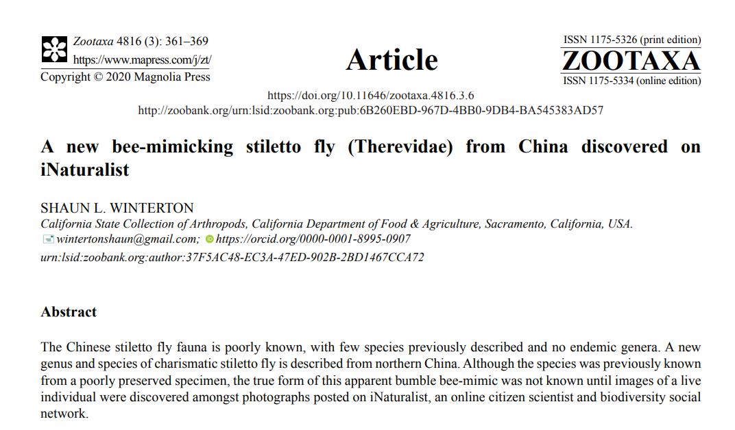
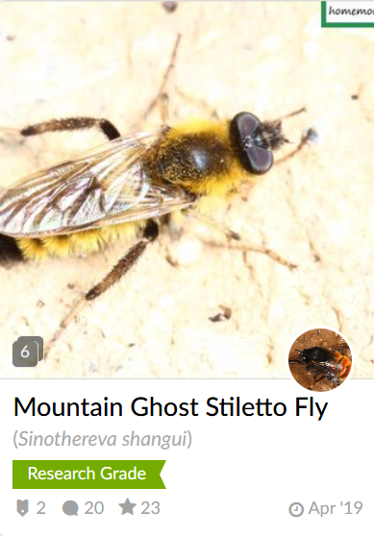

Slide 8
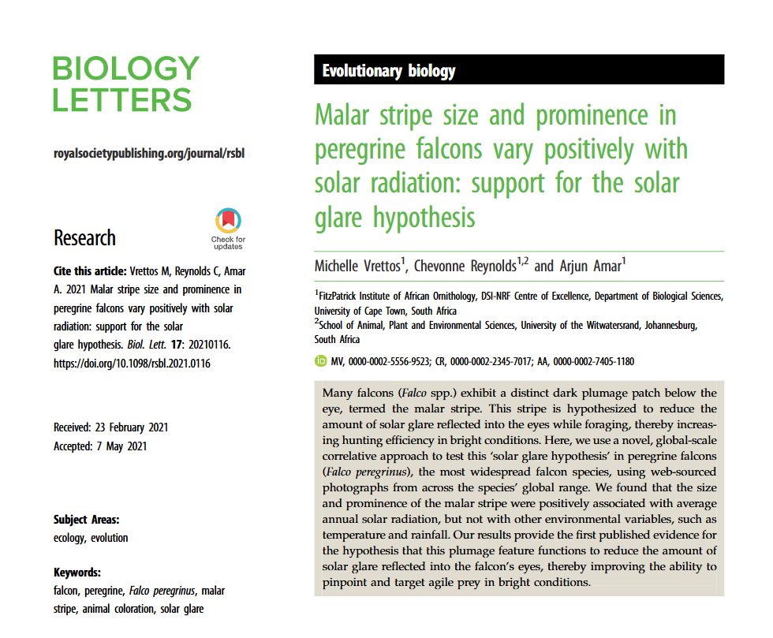
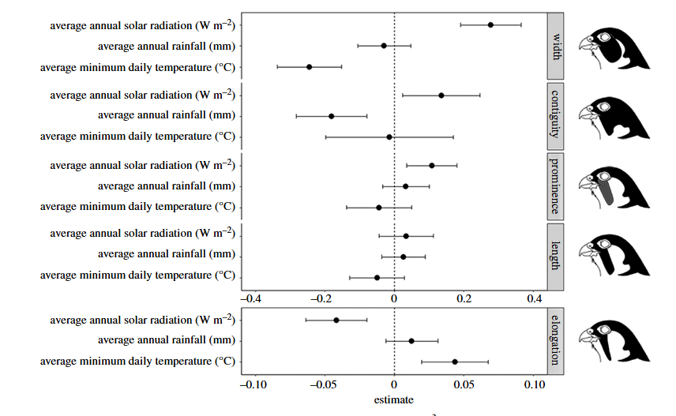
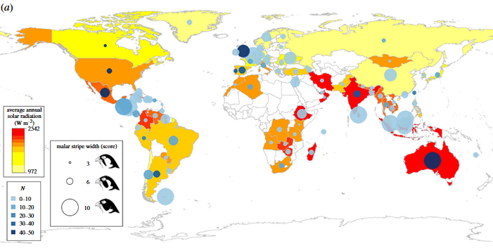

Vrettos, M., Reynolds, C., & Amar, A. (2021). Malar stripe size and prominence in peregrine falcons vary positively with solar radiation: support for the solar glare hypothesis. Biology Letters, 17(6), 20210116.

Slide 9
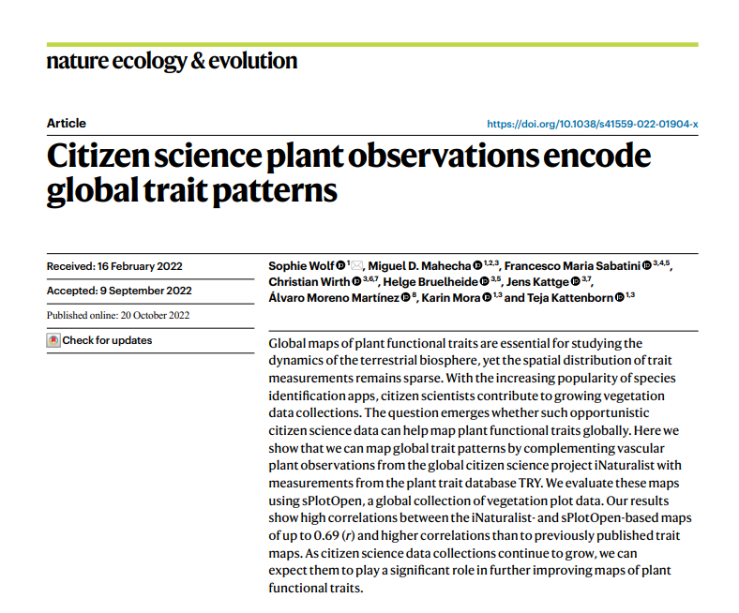
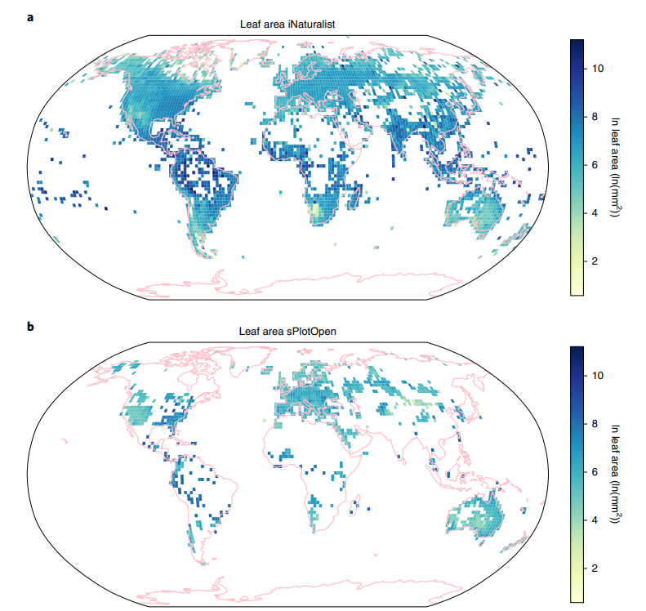
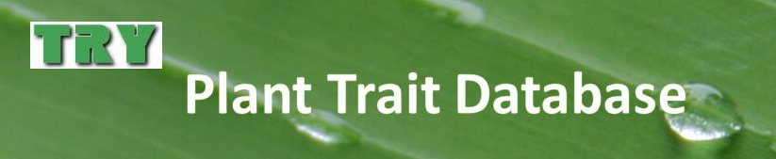
Wolf, S., Mahecha, M. D., Sabatini, F. M., Wirth, C., Bruelheide, H., Kattge, J., ... & Kattenborn, T. (2022). Citizen science plant observations encode global trait patterns. Nature ecology & evolution, 6(12), 1850-1859.

Slide 10
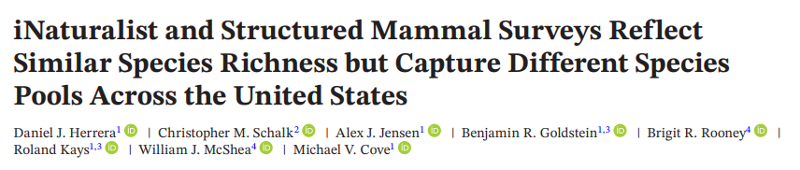
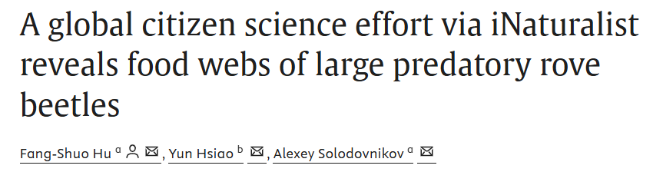
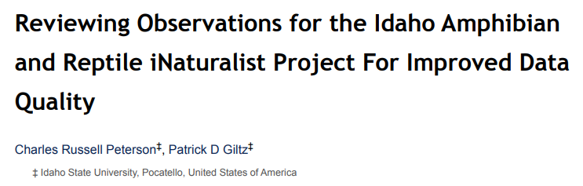
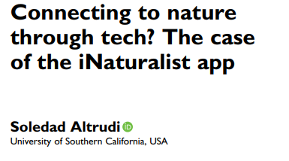
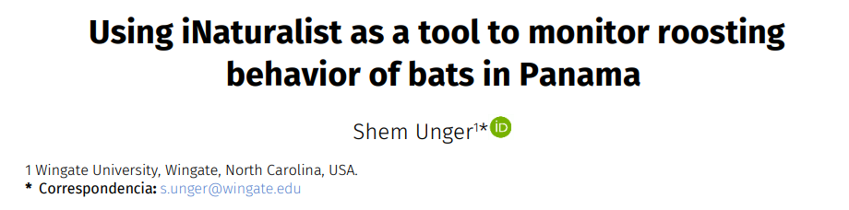
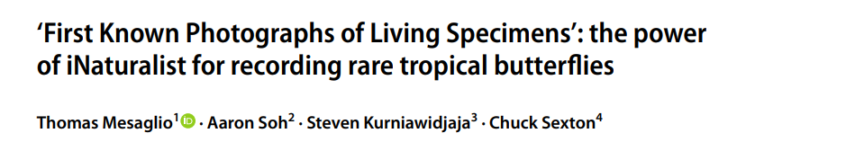
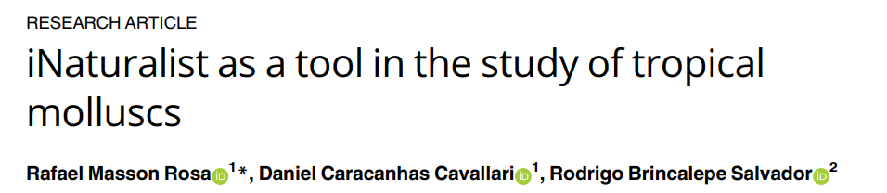
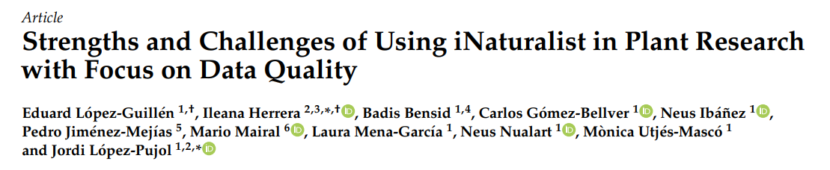
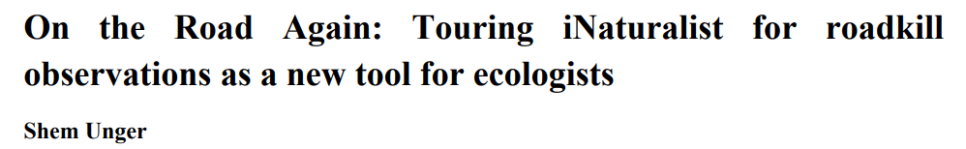

Slide 11
Quantitative look at iNaturalist data usage

Slide 12
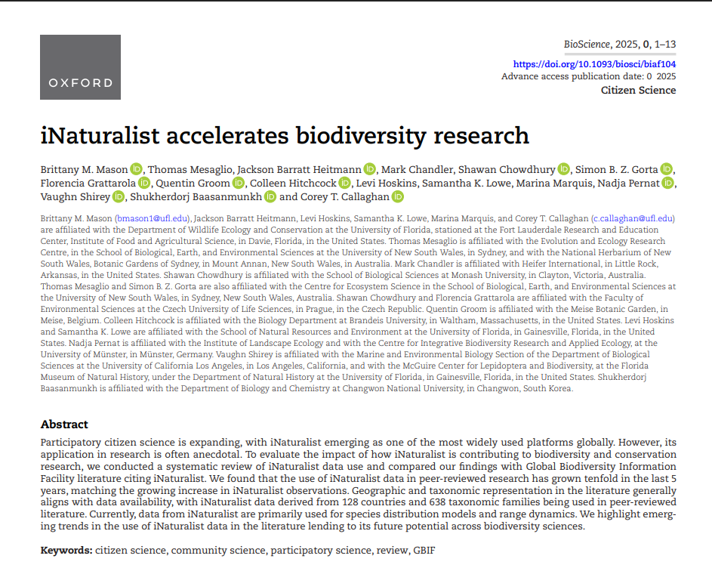
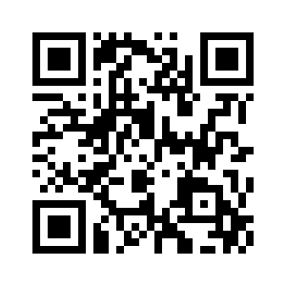
QR code to the full paper

Slide 13





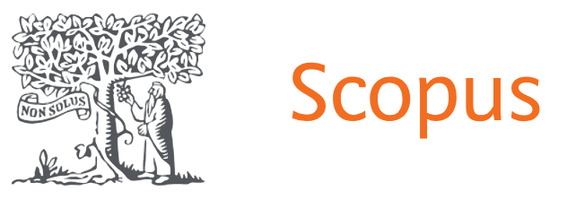




Methods: Obtaining and Sorting Articles
Literature Search
Screened articles for:
Tag articles
iNaturalist
Peer-review
2,137
Articles
Electronically available
Written in English or Spanish
Used iNaturalist data or review of iNaturalist

Slide 14






Methods: Article Tagging Fields
Article Topics
Study Area
Article Topic
Species Distribution/Range
Biology/Behavior
Biodiversity/Population Assessment
Data Quality/Comparison
Climate Change/Environmental Impact
Species Discovery
Education/Community Engagement
Other
Analyses, data type, and data role
Taxonomy
Notes:
It took us many discussions to come up with the tags, and they were based on us reading dozens of articles to determine central themes. We decided to keep the topics broad to provide an overview of how iNaturalist is used in the literature, but within topics there was a variety of studies.

Slide 15
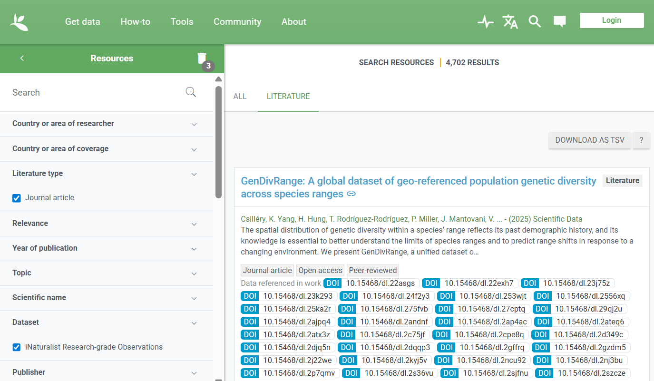
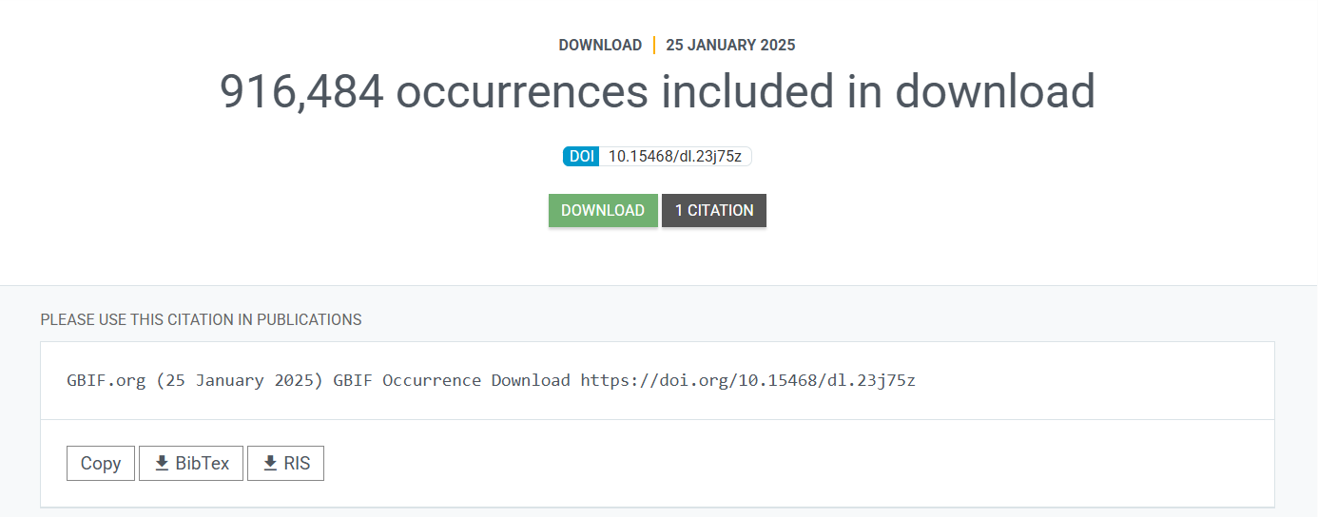
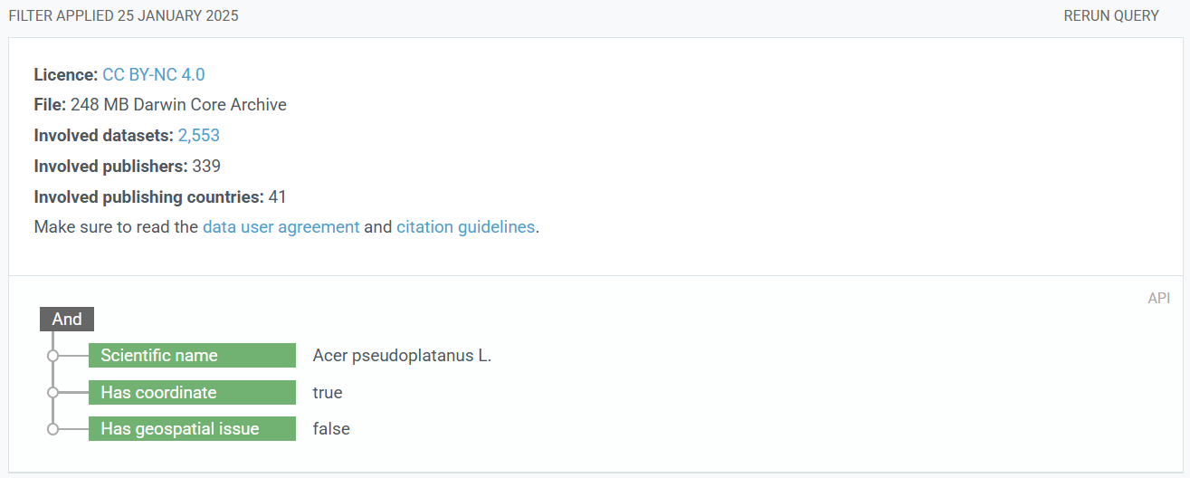
Methods: Supplemental Analysis Using GBIF

Slide 16
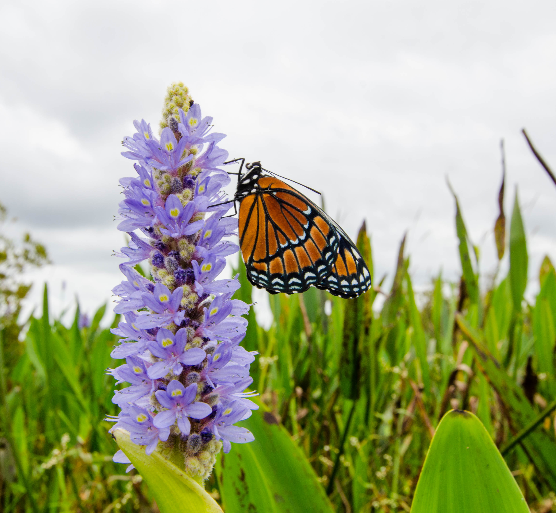
We found that only 10.3% of articles overlapped between the iNaturalist literature search method and GBIF method.

Slide 17
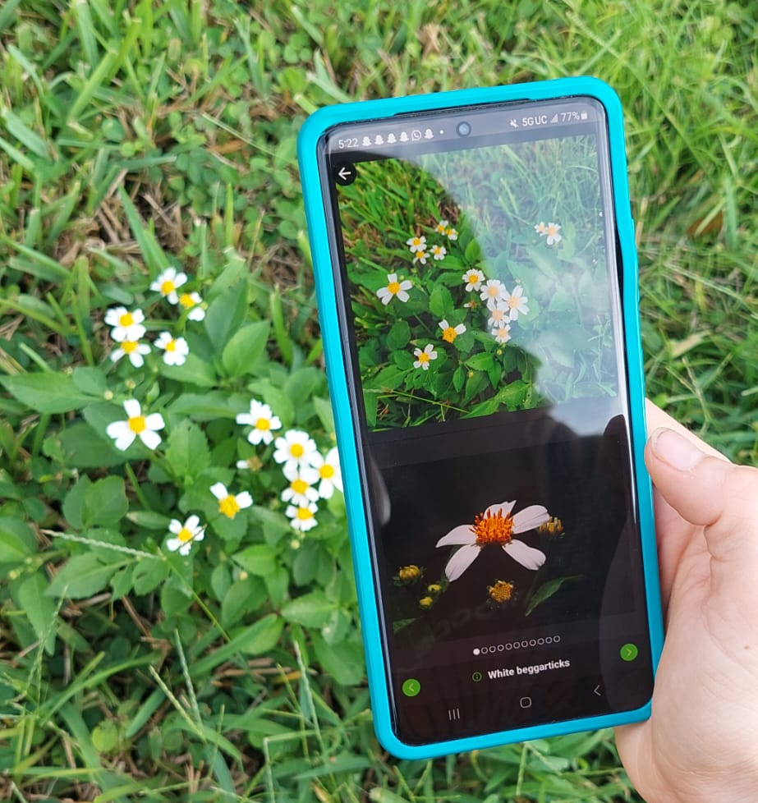
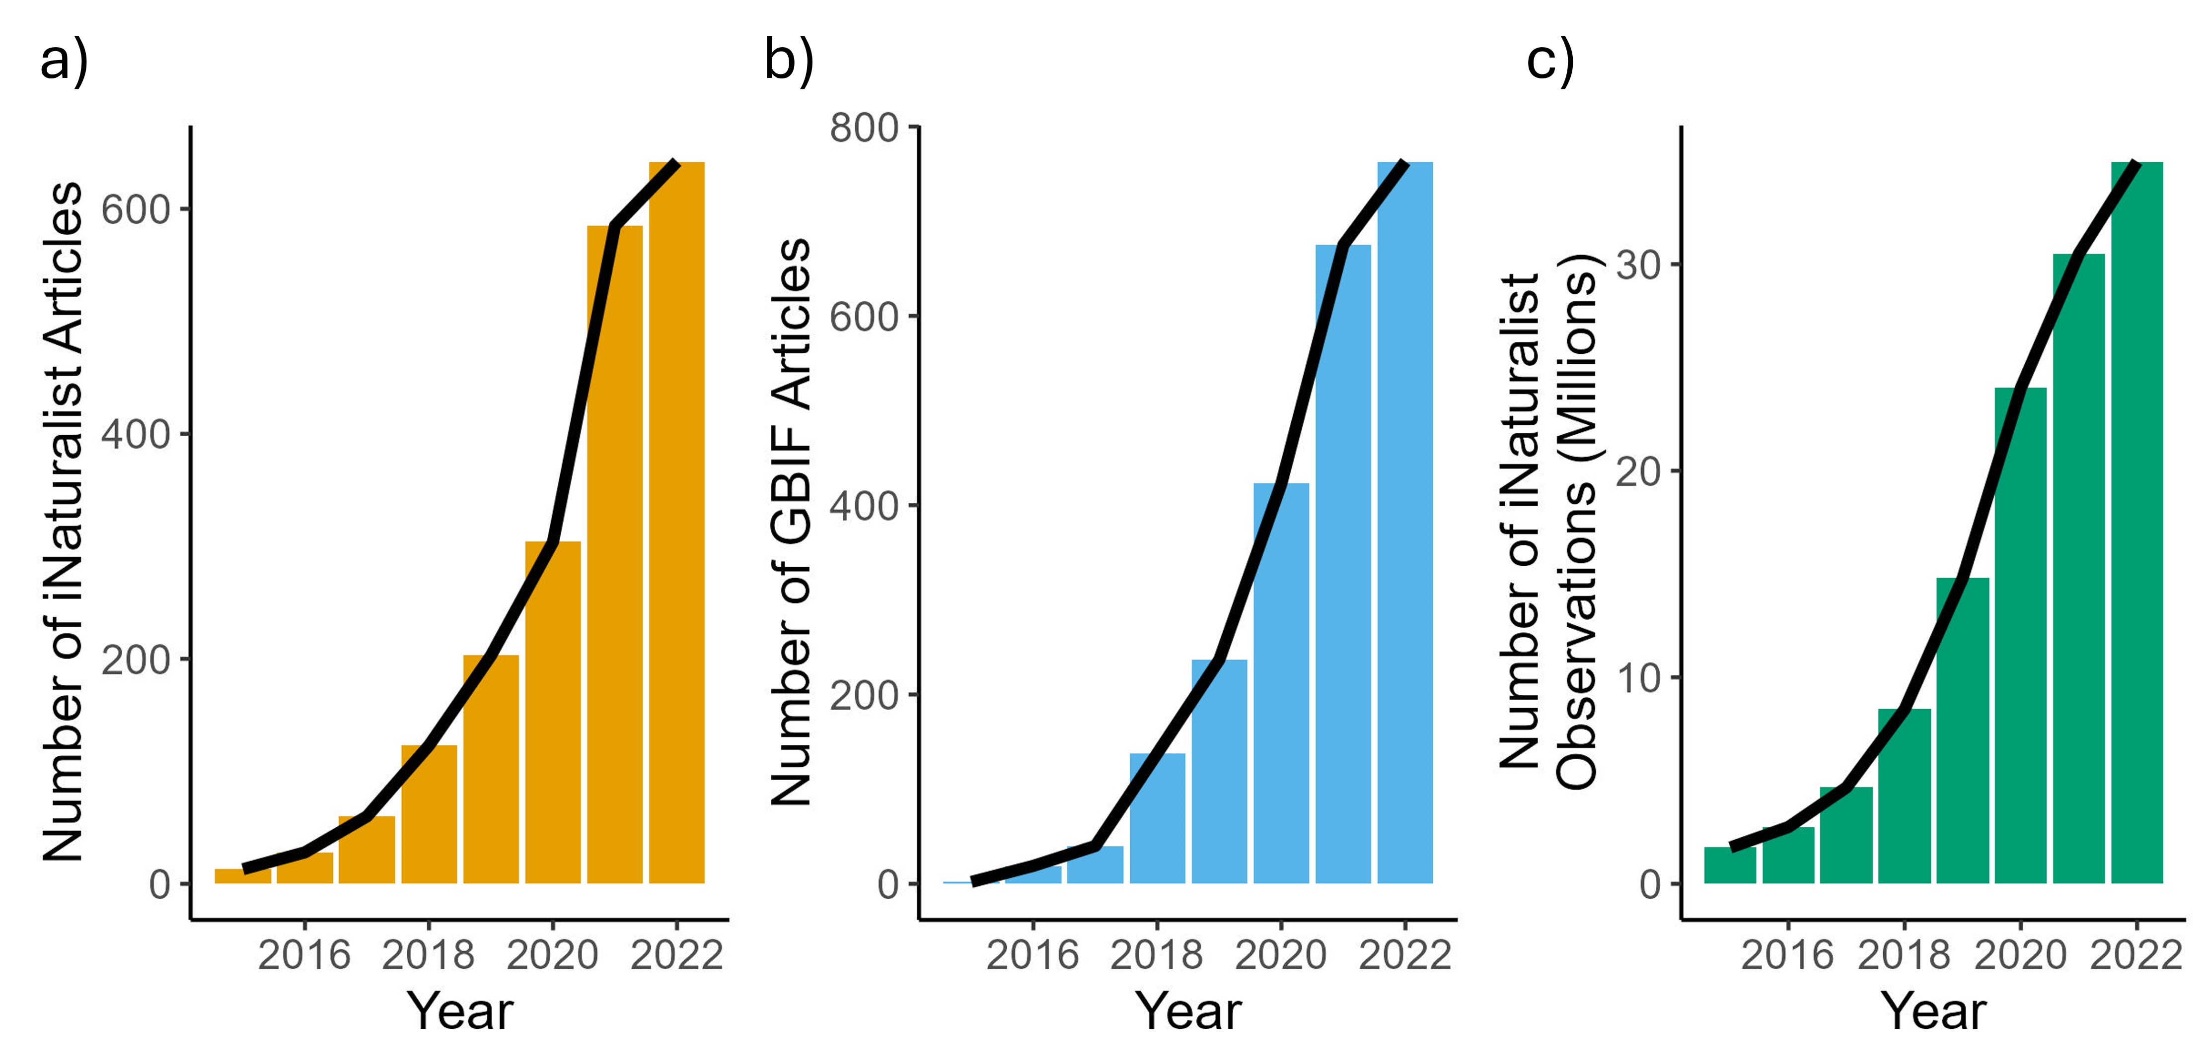
Results: The use of iNaturalist data in scientific literature has grown significantly, paralleling the rapid increase in data availability from the platform.

Slide 18
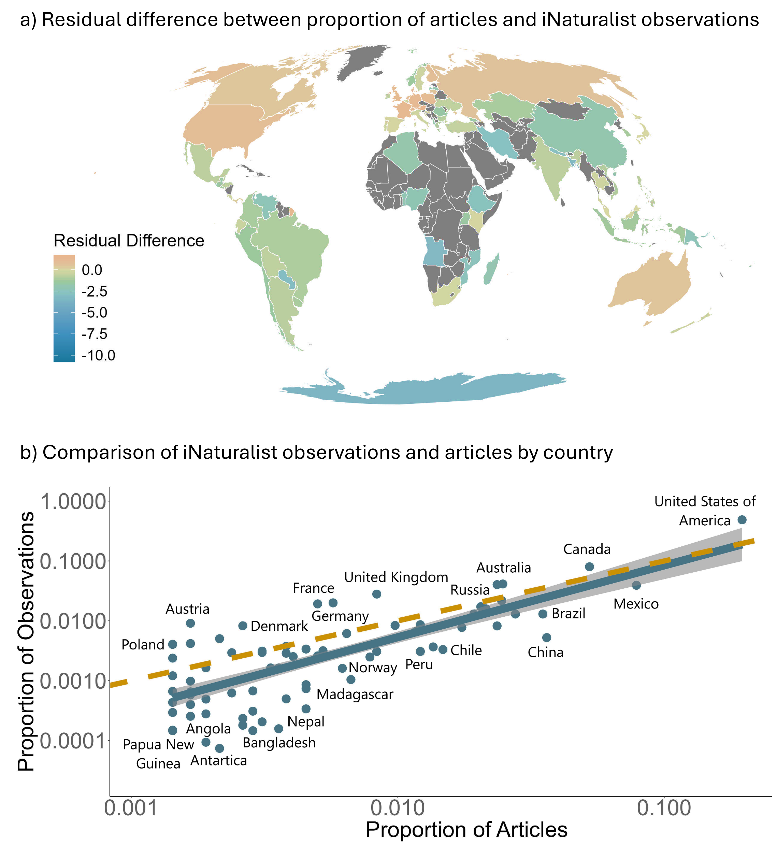
Results: iNaturalist data is used in scientific research from 128 countries
Less articles than expected given the proportion of iNaturalist observations
More articles than expected given the proportion of iNaturalist observations

Slide 19
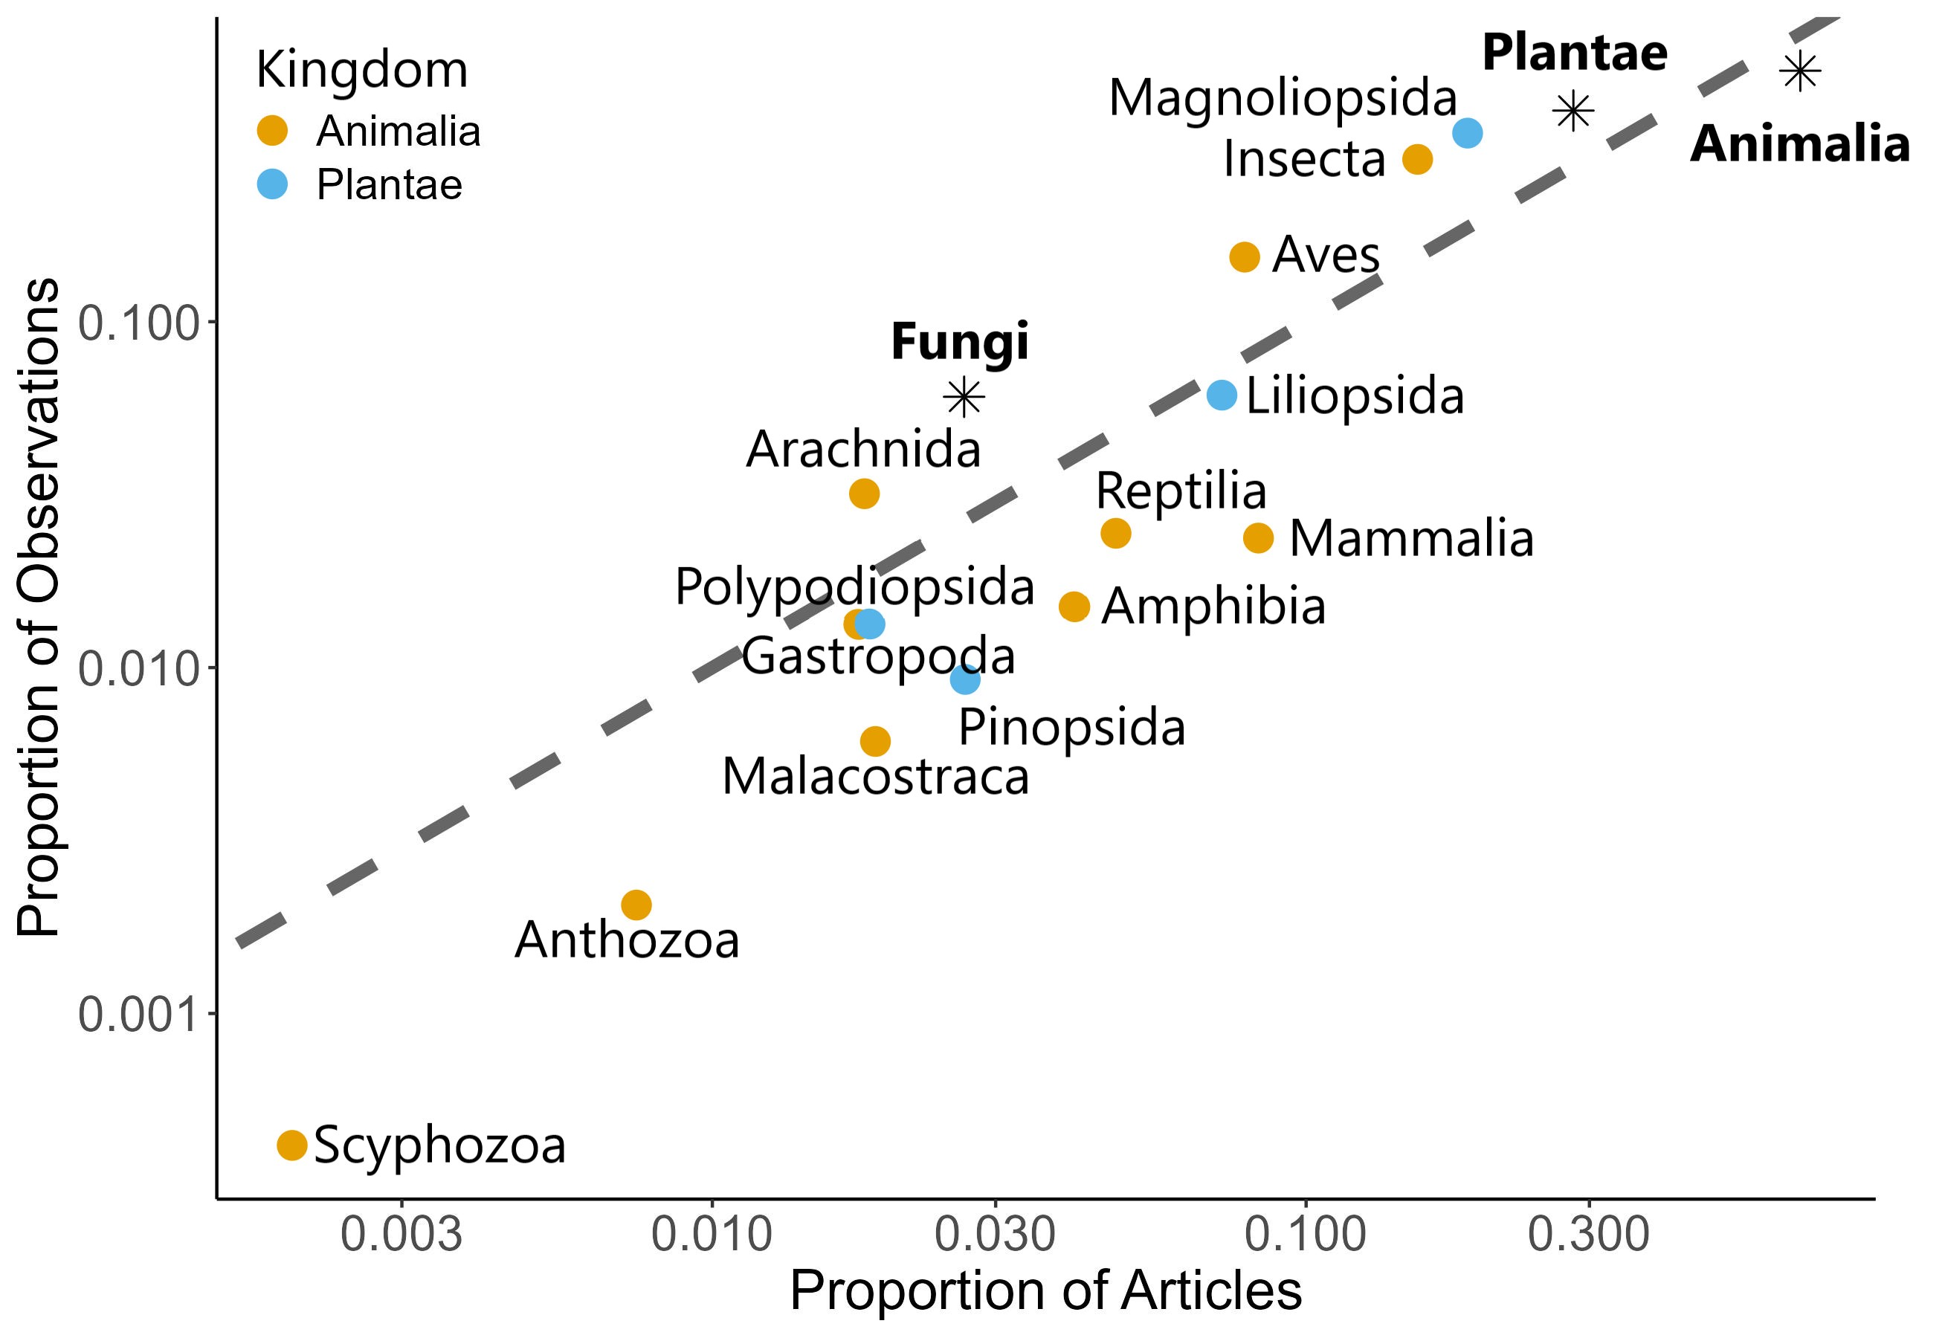






Results: 638 taxonomic families from the iNaturalist literature search
Less articles than expected given the proportion of iNaturalist observations
More articles than expected given the proportion of iNaturalist observations

Slide 20
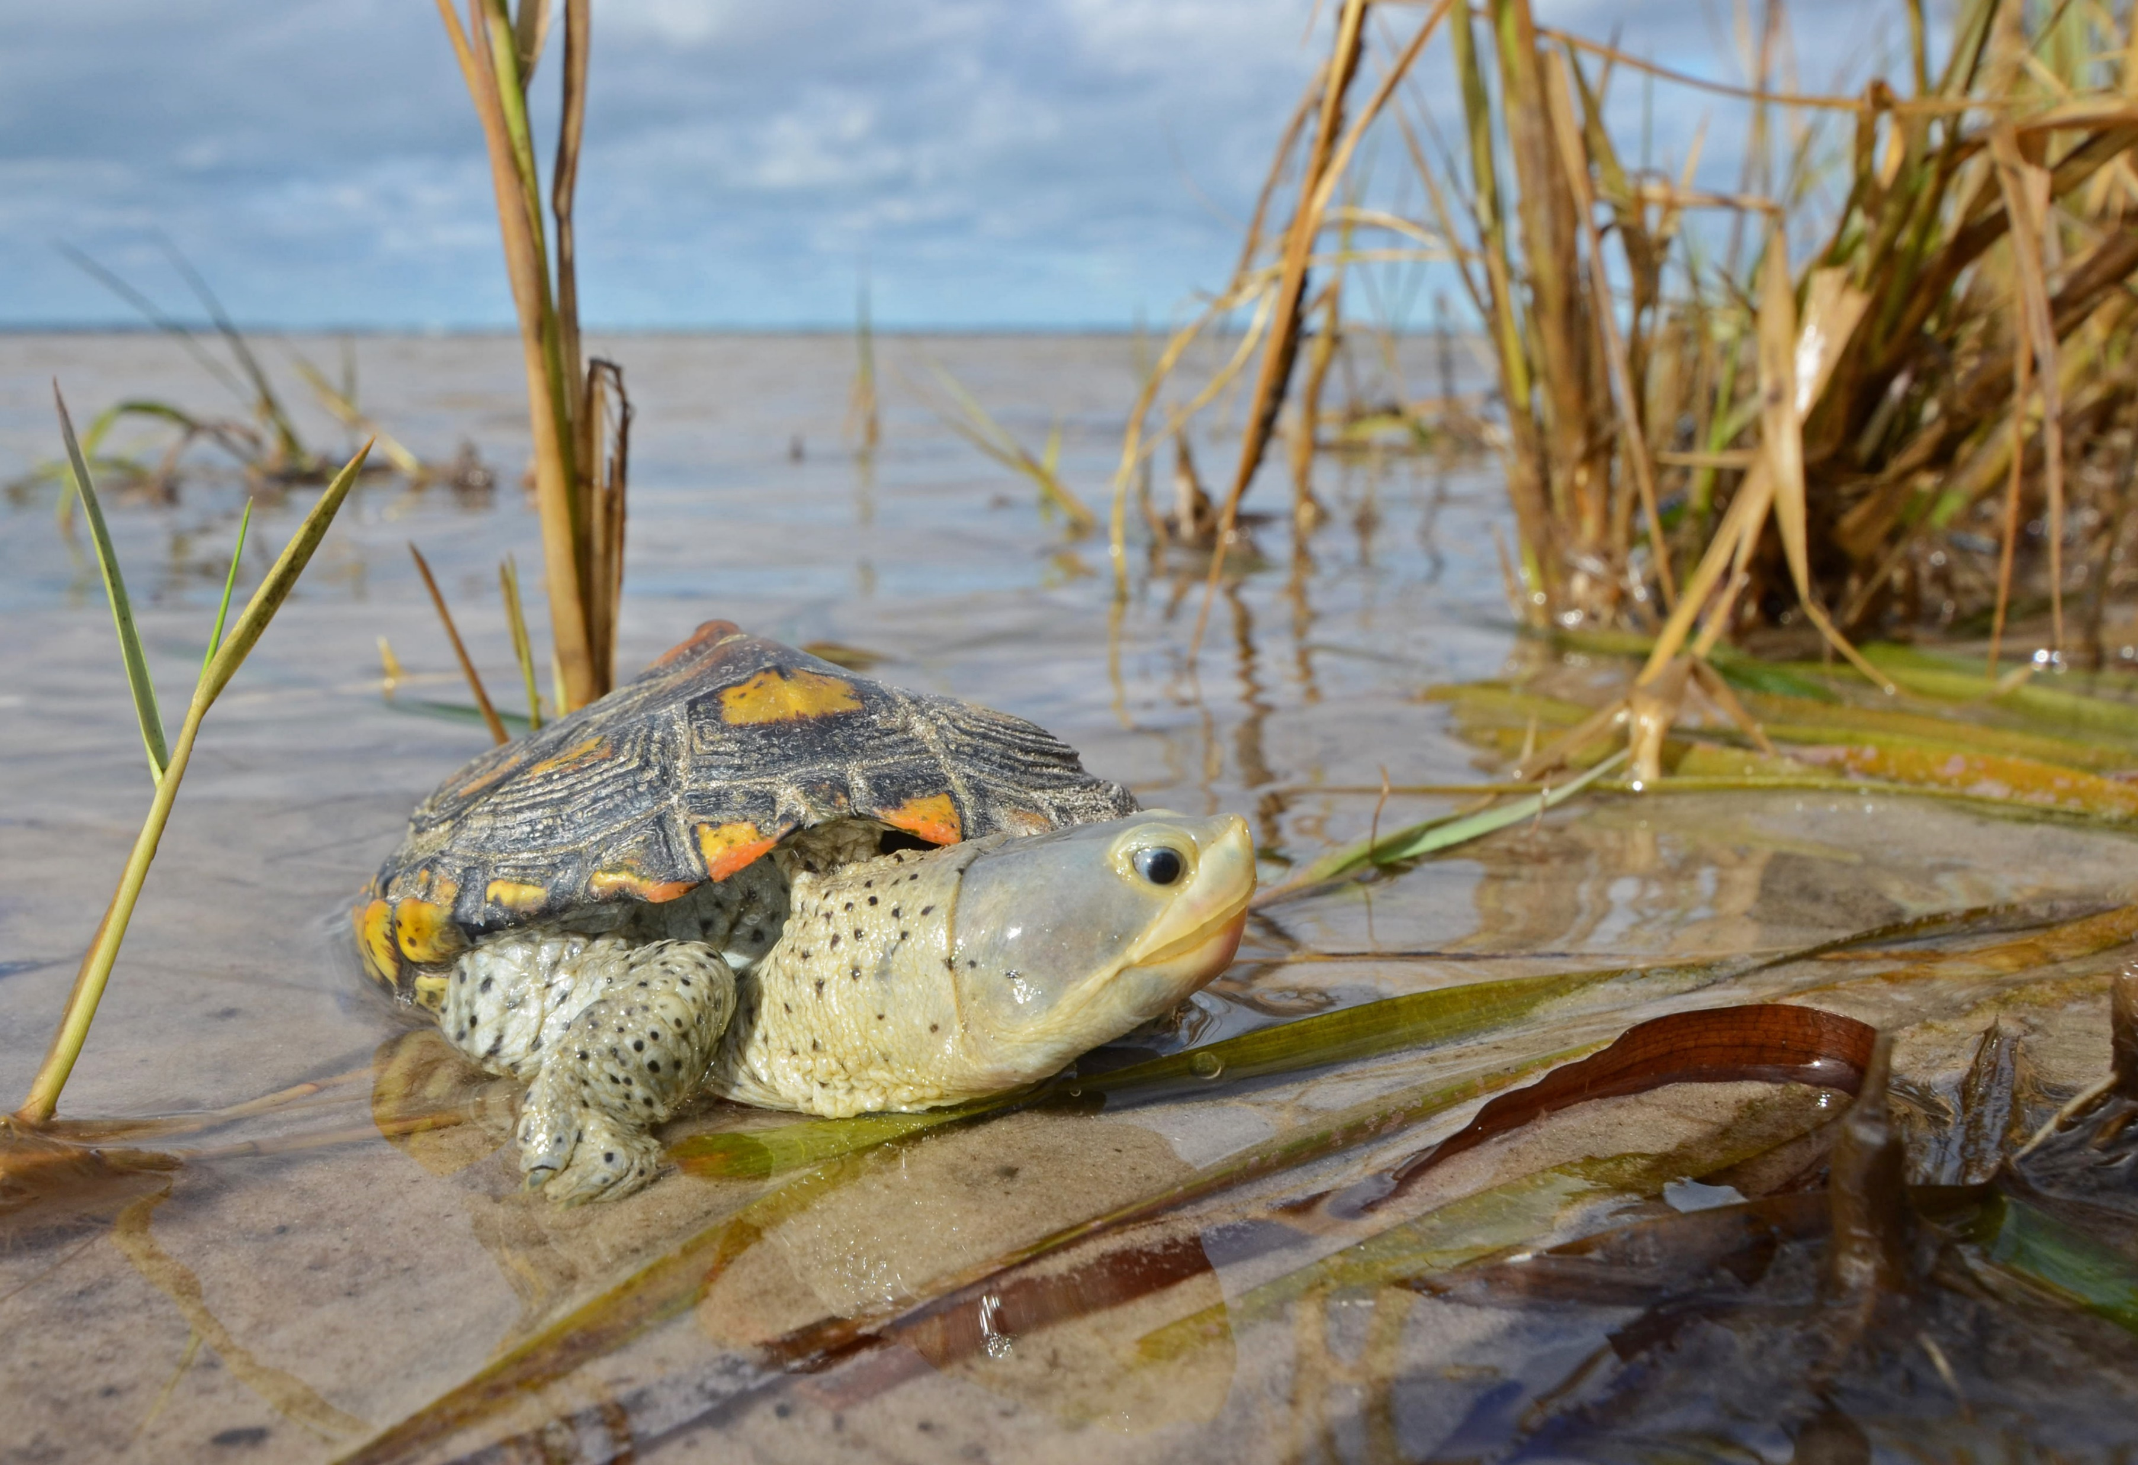
51.5% of articles were focused on three or fewer species

Slide 21
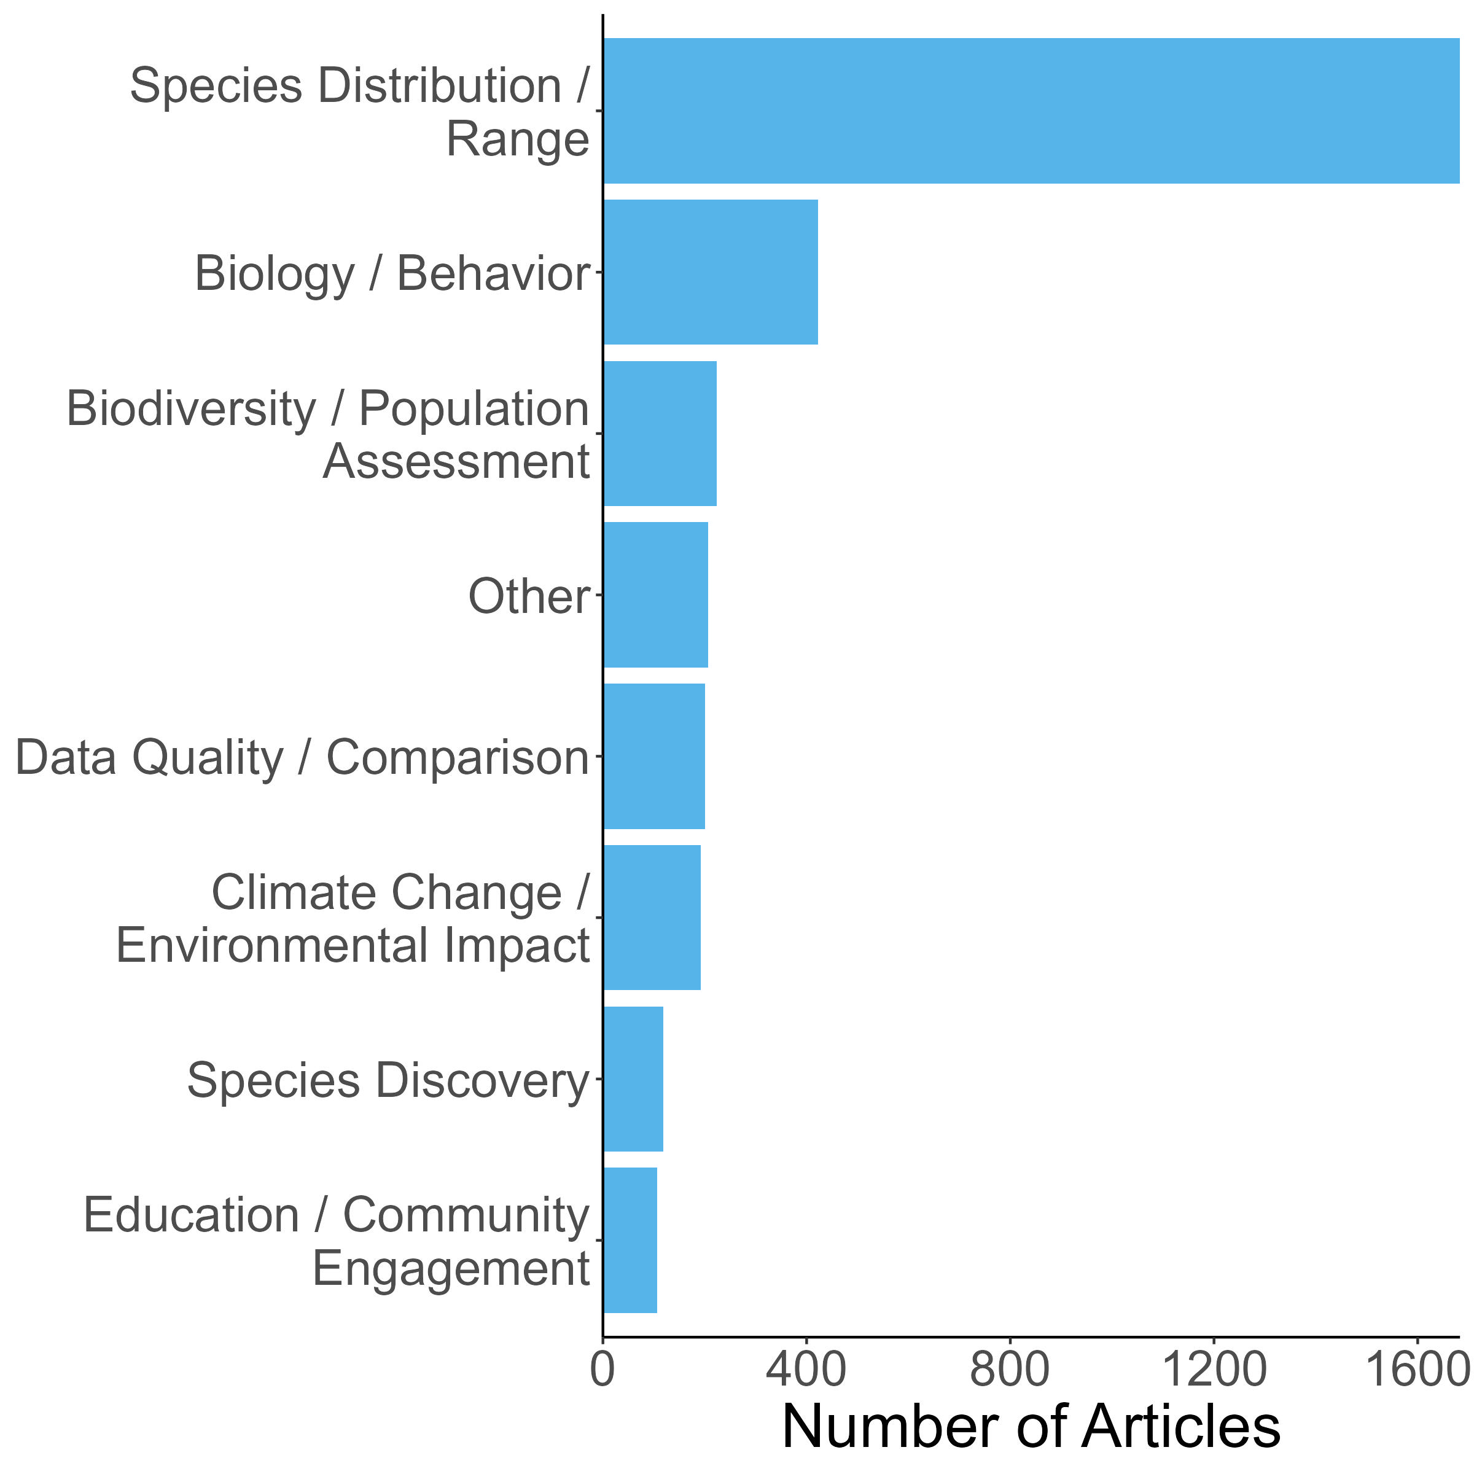
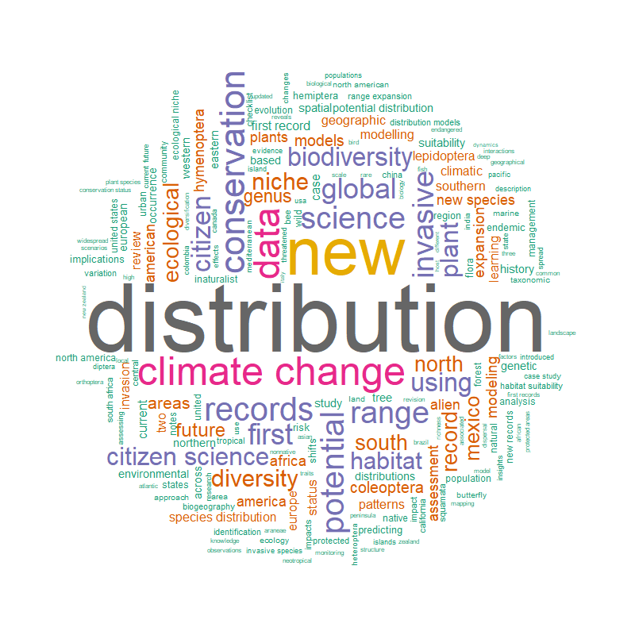
Results: Paper Topics

Slide 22
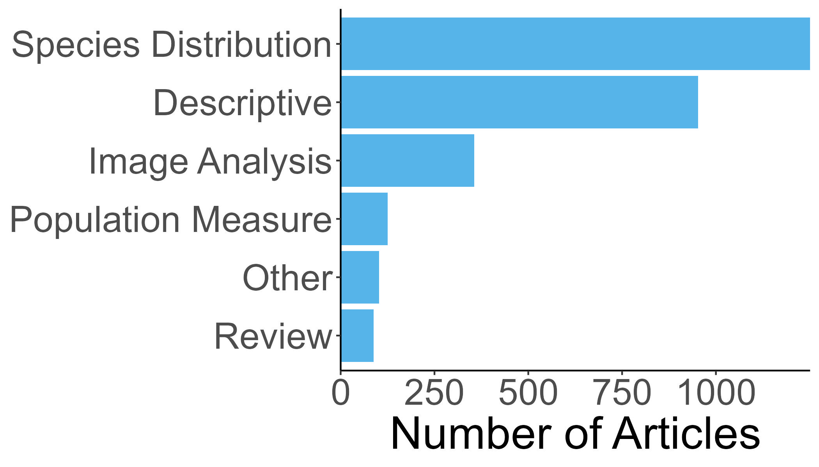
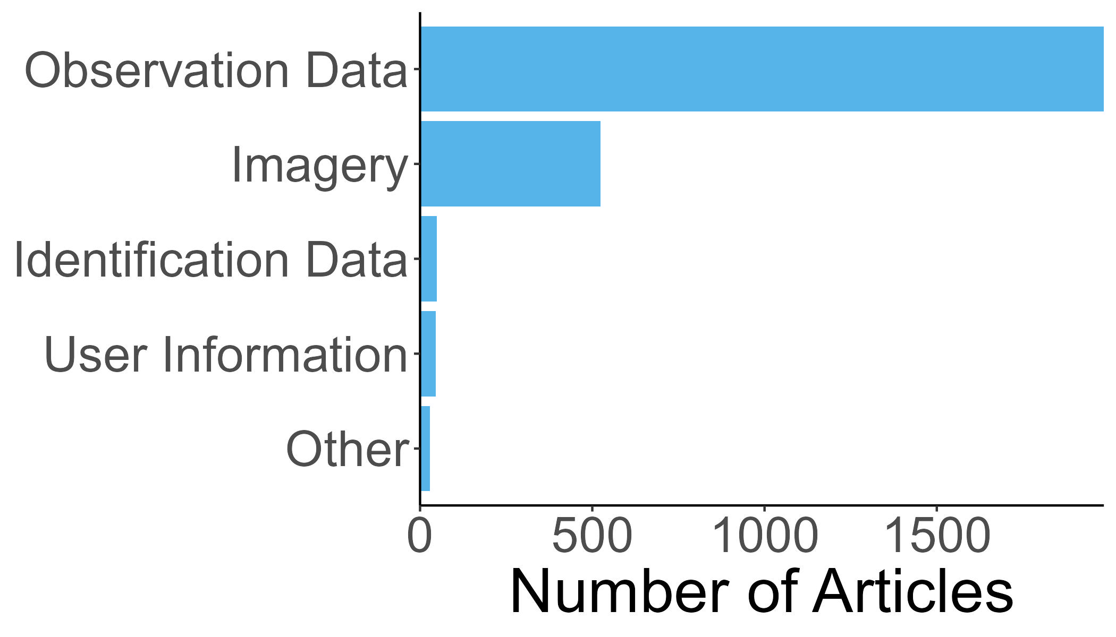
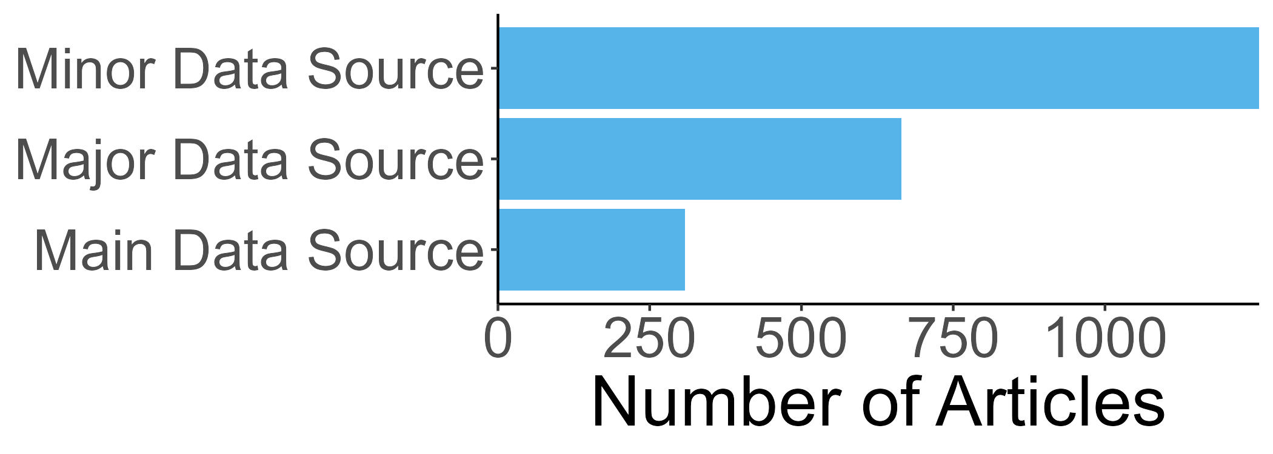
Results: Analyses conducted, data type, and data role
Analyses conducted
iNaturalist data type
iNaturalist data role

Slide 23
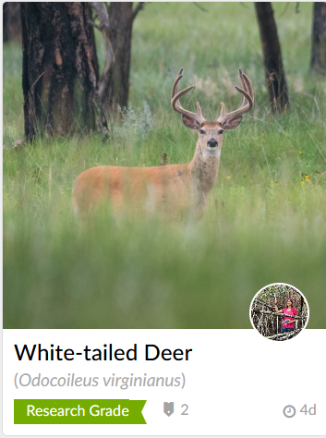
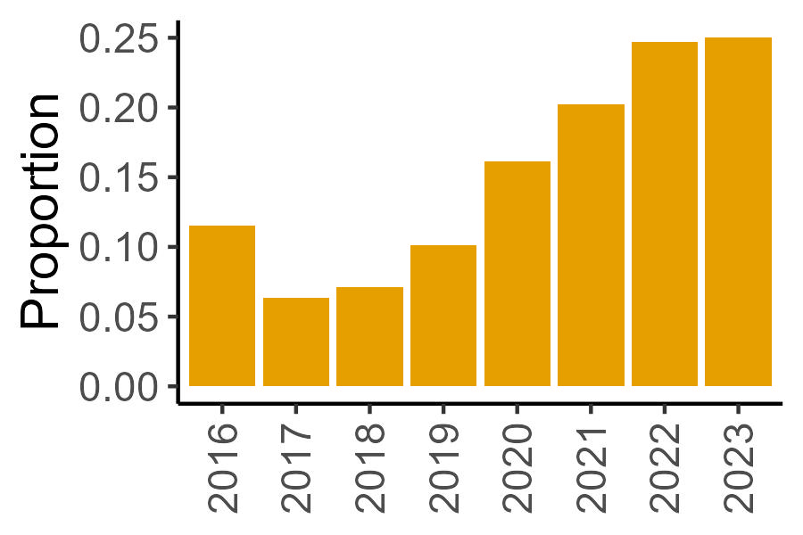
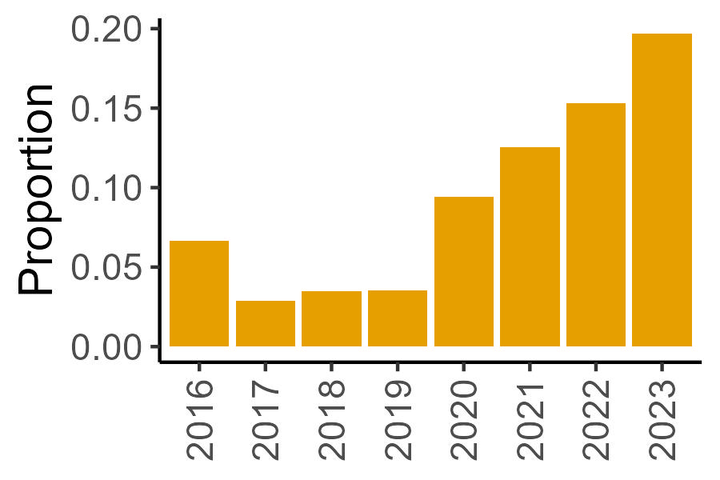
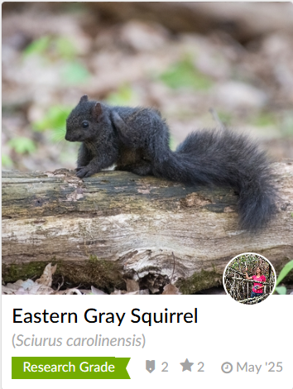
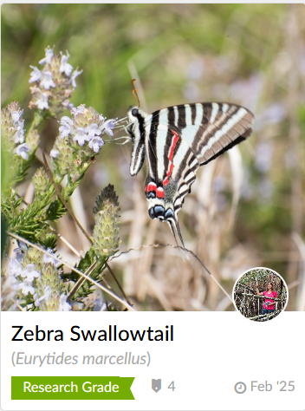
Results: Imagery trends over time
Analyses conducted - Imagery
Analyses data type - Imagery
Notes:
iNaturalist imagery data is often overlooked, but it has been used to study plant-pollinator interactions, feed behavior and prey types, species coloration like we saw earlier with the peregrine falcon study, habitat preferences, and more.

Slide 24





Discussion: Rapid growth of iNaturalist in the literature
We located over 5,000 publications that used iNaturalist data
In the last 5 years, we found a tenfold increase in the use of iNaturalist in the literature
In 2022, four articles were published per day using iNaturalist data
iNaturalist data has been used for research in 128 countries and 638 taxonomic families
Notes:
These numbers were calculated from the articles that we retrieved through June 2023. Since then, the iNaturalist literature has grown. For instance, when I search “iNaturalist” on Google Scholar now, I am getting almost double the hits I did in 2023.

Slide 25

Discussion: iNaturalist Users Take-Away
iNaturalist mission: “connect people to nature and advance biodiversity science and conservation”
iNaturalist is helping democratize data collection:
Anyone can contribute to iNaturalist and, in doing so, play a meaningful role in species management and conservation.
As regional and taxonomic coverage of observations expands, new research opportunities emerge that were previously out of reach.

Slide 26

Discussion: Researcher Take-Away
Research Opportunities: iNaturalist supports a wide range of research applications — with potential growing alongside advances in science and computing.
Targeted Data Collection: Strategic outreach can recruit new users or guide existing ones to collect data tailored to your research needs, and improve regional or taxonomic coverage.
Boosting Data Quality: Contribute identifications to help more observations reach research grade and strengthen the dataset for analysis.

Slide 27

Conclusion: iNaturalist Accelerates Biodiversity Research
iNaturalist:
Enables exploration of large-scale ecological and conservation questions
Supports a wide range of topics — from species discovery and conservation to training machine learning models
Complements professionally collected data to enhance scientific insights
Strengthens biodiversity research through contributions from nearly 4 million users worldwide

Slide 28




Thank you!
Full Paper
Brittany Mason
Data Management Analyst
University of Florida
bmason1@ufl.edu

